Slide 1
Synthetic Opioids May Not Be as Deadly as Previously Thought
Rachel Khoo
Thinkful Capstone 1
August, 2020

Slide 2
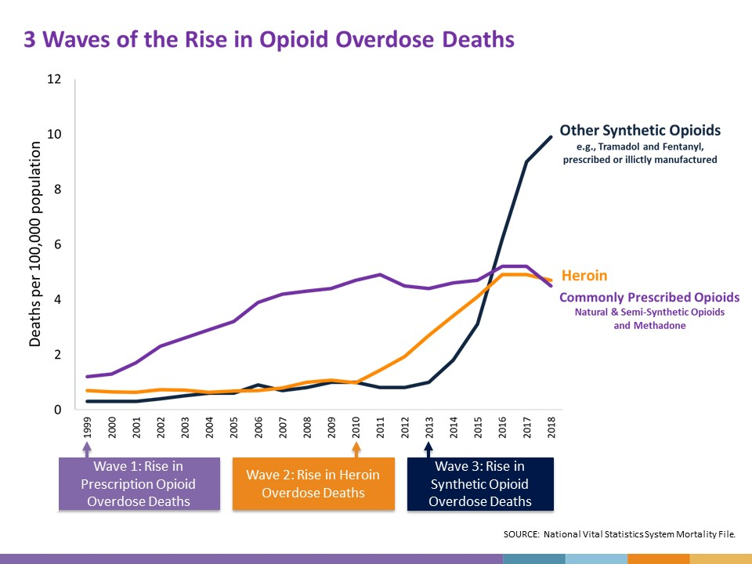
Will decreasing synthetic prescriptions decrease overdose deaths?
Includes illicitly manufactured
Notes:
In 2017, the US Dept. of Health and Human Services declare a public health emergency regarding the widespread abuse of opioids.
What are opioids?

Slide 3
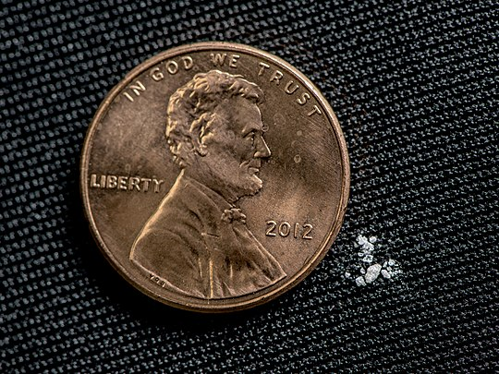
“Synthetics are dangerous”
Hydrocodone
Oxycodone
Codeine
Morphine
Fentanyl
Tramadol
Notes:
This project focuses on synthetic opioids such as fentanyl and tramadol. The image shows approx. 2mg of fentanyl, a lethal dose.
Note: Will not be including Methadone

Slide 4
Prescribed synthetics have negative or no correlation to deaths
There is a difference between synthetic use in all US regions except between the North East and the Midwest
The Midwest’s death rate is much lower than the North East;
South and West have similar deaths

Slide 5

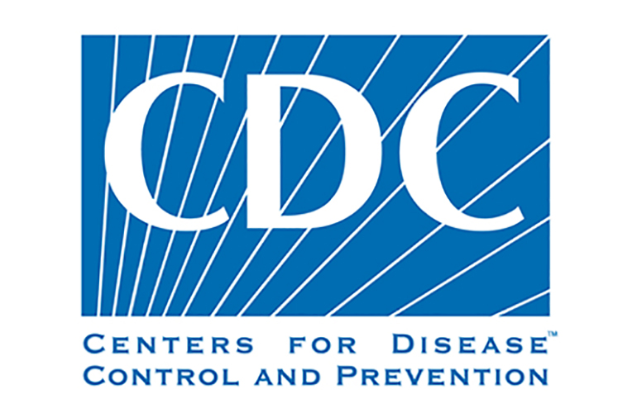
The findings are limited to medicare users
For the year 2014
From Medicare
14.5k unique opioid prescribers
Compiled by Kaggle User
Alan “AJ” Pryor, Ph.D.
Notes:
Centers for Medicaid and Medicare Services and the CDC
Two main tables used
National Provider Identifier

Slide 6
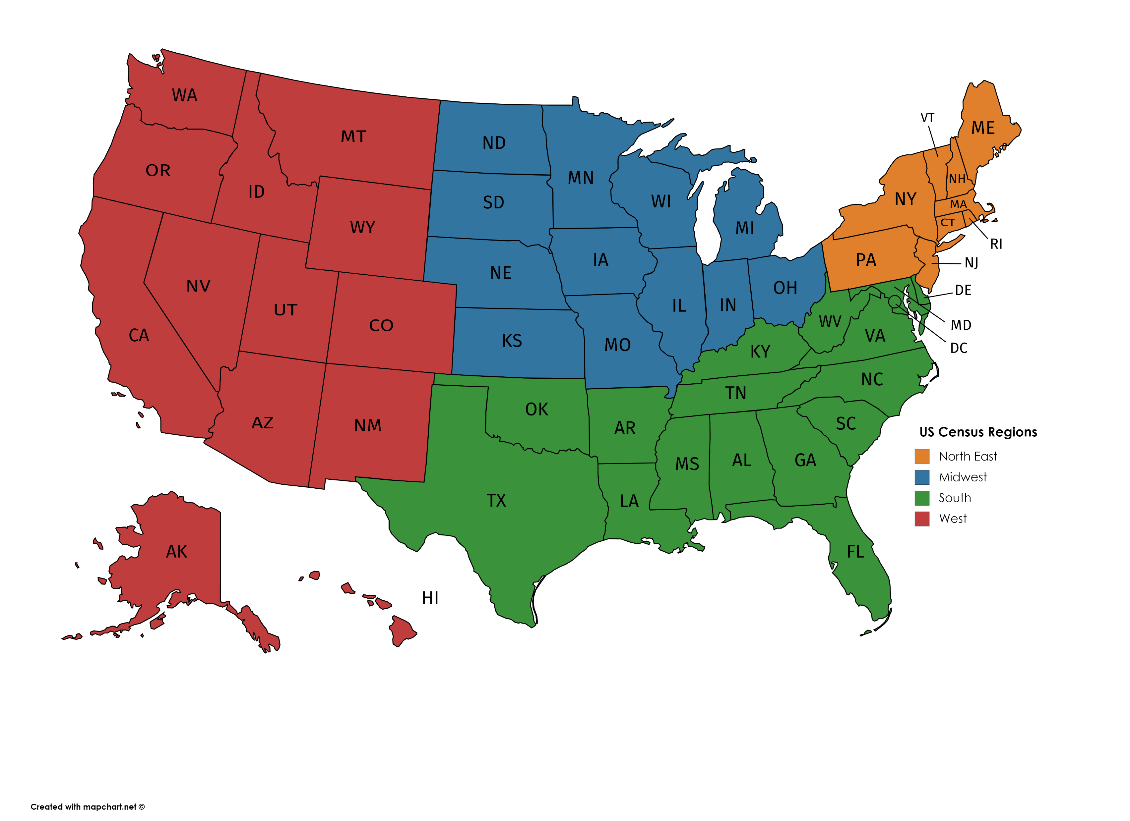
Regional Differences

Slide 7
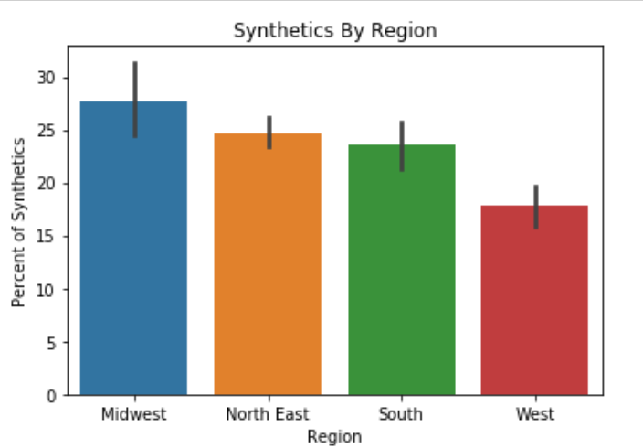
Notes:
The effect size is less than 50% for each pairing

Slide 8
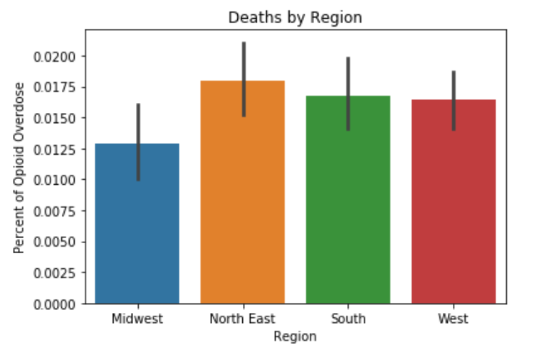

Slide 9
South and West have very different synthetic percentages, but similar deaths
Midwest has highest synthetics, but lowest deaths

Slide 10
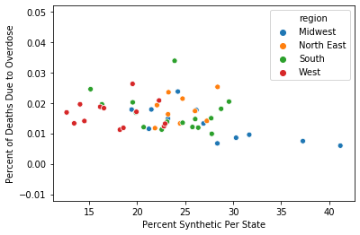

Slide 11
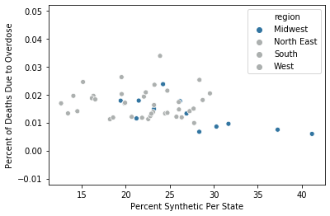

Slide 12
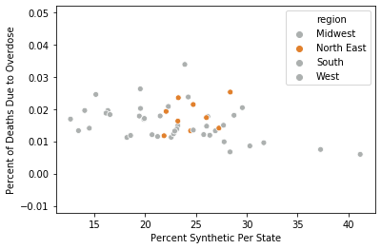

Slide 13
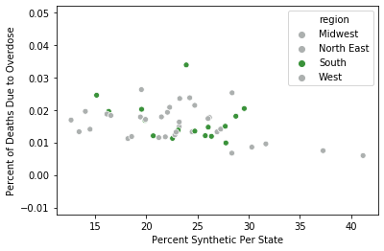

Slide 14
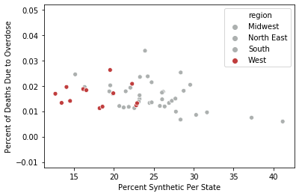

Slide 15
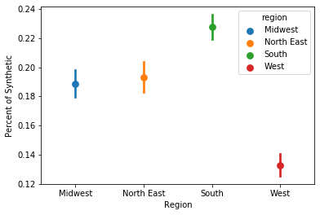
Is there a regional difference in synthetic percentages?
Kruskal-Wallis Test
Small differences between each group

Slide 16
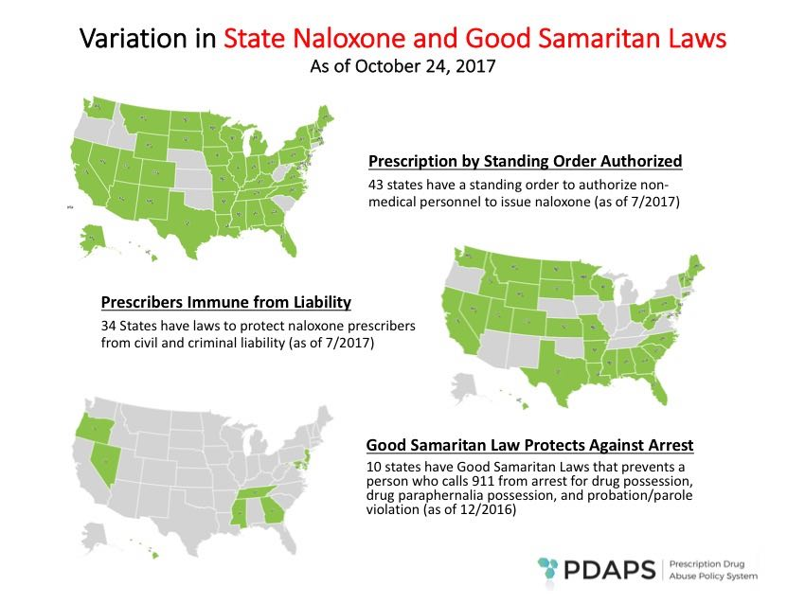
Other regional factors may be at play
Naloxone (Narcan) access
Dependence programs
Income

Slide 17

Further research is needed
Different insurance providers
Deaths on a per-doctor basis
Regional effects

